Slide 1
A340 Lecture 15
PDF
XML
RSS

Slide 2
PDF
Portable Document Format from Adobe
Records typesetting information
Fonts: glyphs and encoding
Images
Line breaks, Pagination
Lines, Shading
May contain:
Form tags
Encryption
Printer/viewer controls
Requires a reader: (Adobe Acrobat)

Slide 3
PDF and PHP
Built-in support for PHP is being redesigned and was removed from the standard PHP library
PDF-PHP
supports ez and primative
source
http://sourceforge.net/projects/pdf-php/ http://ros.co.nz/pdf/
documentation:
http://ros.co.nz/pdf/readme.pdf

Slide 4
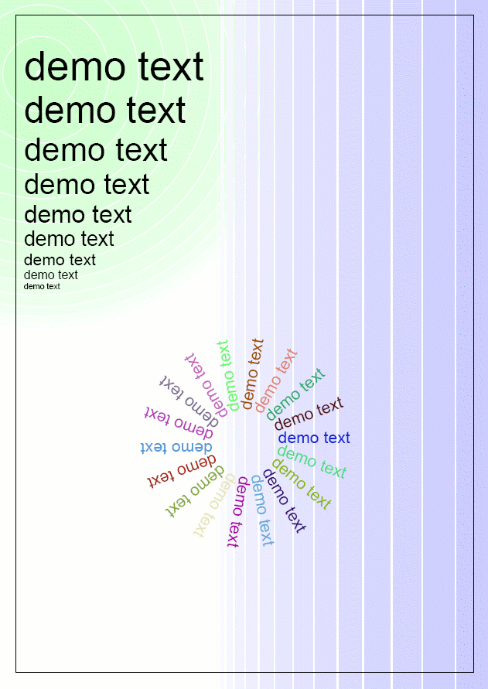
PDF Primitive
Emulates a plotter
Gives full control of graphics/position
Shading control
Direction control

Slide 5
PDF Primitive:
include ('class.ezpdf.php');
$pdf =& new Cpdf();
$pdata = array(200,10,400,20,300,50,150,40);
$pdf->polygon($pdata,4,1);
$pdf->polygon($pdata,4); $pdf->setColor(0.9,0.9,0.9);
$pdf->polygon($pdata,4,1);
$pdf->addText(150,$y,10,"the quick brown fox ". "<b>jumps</b><i>over</i> the lazy dog!",-10);
$pdf->setLineStyle(4,'round','',array(0,6,4,6));
$pdf->ellipse(300,$y+25,40,20,45);
$pdf->Output();

Slide 6
PDF primitive
include 'class.pdf.php';
$demotext='demo text';
$pdf = new Cpdf(array(0,0,598,842));
$pdf->selectFont('./fonts/Helvetica');
// Circles
$x=578;
$r1=25;
for ($xw=40;$xw>0;$xw-=3)
{
$tone=1.0-$xw/40*0.2;
$pdf->setLineStyle($xw);
$pdf->setStrokeColor($tone,1,$tone);
$pdf->ellipse(50,750,$r1);
$r1=$r1+$xw;
}

Slide 7
PDF primitive (continued)
// Lines
for ($xw=40;$xw>0;$xw-=3)
{
$tone=1.0-$xw/40*0.2;
$pdf->setStrokeColor($tone,$tone,1);
$pdf->setLineStyle($xw);
$pdf->line($x,0,$x,842);
$x=$x-$xw-2;
}
// Border
$pdf->setStrokeColor(0,0,0);
$pdf->setLineStyle(1);
$pdf->rectangle(20,20,558,802);

Slide 8
PDF primitive (continued)
$y=800;
for ($size=50;$size>5;$size=$size-5)
{ $height = $pdf->getFontHeight($size);
$y=$y-$height;
$pdf->addText(30,$y,$size,$demotext);
}
for ($angle=0;$angle<360;$angle=$angle+20)
{ $r=rand(0,100)/100; $g=rand(0,100)/100;
$b=rand(0,100)/100;
$pdf->setColor($r,$g,$b);
$pdf->addText(300+cos(deg2rad($angle))*40,300- sin(deg2rad($angle))*sin(deg2rad($angle))*40,20,
$demotext,$angle);
}
$pdf->stream();

Slide 9
ezPDF
<?php
include ('class.ezpdf.php');
$pdf =& new Cezpdf();
$pdf->selectFont('./fonts/Helvetica.afm');
$pdf->ezText('Hello World!',50);
$pdf->ezStream();
?>

Slide 10
ezPDF Table
include ('class.ezpdf.php');
$pdf =& new Cezpdf();
$pdf->selectFont('./fonts/Helvetica.afm');
$data = array(
array('num'=>1,'name'=>'gandalf','type'=>'wizard'),
array('num'=>2,'name'=>'bilbo','type'=>'hobbit'),
array('num'=>3,'name'=>'frodo','type'=>'hobbit'),
array('num'=>4,'name'=>'saruman','type'=>'bad dude'),
array('num'=>5,'name'=>'sauron','type'=>'really bad dude')
);
$pdf->ezTable($data);
$pdf->ezOutput();

Slide 11
XML
Strict tag rules
Built in checks for well-formedness
Can be used for textbases and databases
Browser support:
CSS, XSLT and XSL formatting
XQUERY and XQL
http://www.w3.org/XML/

Slide 12
XML
XML stands for EXtensible Markup Language
XML is a markup language much like HTML
XML was designed to describe data
XML tags are not predefined. You must define your own tags
XML uses a Document Type Definition (DTD) or an XML Schema to describe the data
XML with a DTD or XML Schema is designed to be self-descriptive
XML is a W3C Recommendation
XML is a cross-platform, software and hardware independent tool for transmitting information.

Slide 13
Applications of XML
XML is used to Exchange Data
With XML, data can be exchanged between incompatible systems.
With XML, financial information can be exchanged over the Internet.
XML can be used to Share Data even complex data forms
XML can be used to Store Data that can be read well into the future
XML can make your Data more Useful
XML can be used to Create new Languages, Protocols and services
XML is the mother of RSS, WAP and WML.
If Developers have Sense, all future applications will exchange their data in XML.

Slide 14
A sample file
<?xml version="1.0" encoding="ISO-8859-1"?>
<note>
<to>Tove</to>
<from>Jani</from>
<heading>Reminder</heading>
<body>
Don't forget me this weekend!
</body>
</note>

Slide 15
Some basic rules
All XML elements must have a closing tag
XML tags are case sensitive
All XML elements must be properly nested
All XML documents must have a root element
Attribute values must always be quoted
With XML, white space is preserved
With XML, CR / LF is converted to LF
Comments in XML: <!-- This is a comment -->

Slide 16
Naming xml elements
Names can contain letters, numbers, and other characters
Names must not start with a number or punctuation character
Names must not start with the letters xml (or XML, or Xml, etc)
Names cannot contain spaces

Slide 17
Use of Elements vs. Attributes
Attributes:
<person sex="female">
<firstname>Anna</firstname>
<lastname>Smith</lastname>
</person>
Elements:
<person>
<sex>female</sex>
<firstname>Anna</firstname>
<lastname>Smith</lastname>
</person>

Slide 18
Child elements
<note>
<date>
<day>12</day>
<month>11</month>
<year>2002</year>
</date>
<to>Tove</to>
<from>Jani</from>
<heading>Reminder</heading>
<body>Don't forget me this weekend!</body>
</note>

Slide 19
Some problem using attributes
attributes cannot contain multiple values (child elements can)
attributes are not easily expandable (for future changes)
attributes cannot describe structures (child elements can)
attributes are more difficult to manipulate by program code
attribute values are not easy to test against a Document Type Definition (DTD) - which is used to define the legal elements of an XML document

Slide 20
An absurd example
<note day="12" month="11" year="2002" to="Tove" from="Jani" heading="Reminder" body="Don't forget me this weekend!">
</note>

Slide 21
But a common use for attributes…
<messages>
<note id="p501">
<to>Tove</to>
<from>Jani</from>
<heading>Reminder</heading>
<body>Don't forget me this weekend!</body>
</note>
<note id="p502">
<to>Jani</to>
<from>Tove</from>
<heading>Re: Reminder</heading>
<body>I will not!</body>
</note>
</messages>

Slide 22
Well-formed
<?xml version="1.0" encoding="ISO-8859-1"?>
<!DOCTYPE note SYSTEM "InternalNote.dtd">
<note>
<to>Tove</to>
<from>Jani</from>
<heading>Reminder</heading>
<body>Don't forget me this weekend!</body>
</note>

Slide 23
DTD
<!ELEMENT note (to,from,heading,body)>
<!ELEMENT to (#PCDATA)>
<!ELEMENT from (#PCDATA)>
<!ELEMENT heading (#PCDATA)>
<!ELEMENT body (#PCDATA)>

Slide 24
XSL
Extensible Stylesheet Language (XSL)
XSL describes how the XML document should be displayed
XSL consists of three parts:
XSLT - a language for transforming XML documents
XPath - a language for navigating in XML documents
XSL-FO - a language for formatting XML documents

Slide 25
XSL Browsers
Firefox 1.0.2 (XML+XSLT + CSS).
Mozilla 1.7.8 (XML + CSS + XSLT)
Netscape 8 (Same as Mozilla)
Opera 8 (XML + CSS)
Internet Explorer 6 (XML+CSS+XSLT)
Internet Explorer 5 (XML+CSS)

Slide 26
Style sheet declaration
Stylesheet:
<xsl:stylesheet version="1.0" xmlns:xsl="http://www.w3.org/1999/XSL/Transform">
Transform:
<xsl:transform version="1.0" xmlns:xsl="http://www.w3.org/1999/XSL/Transform">

Slide 27
Typical stylesheet
<?xml version="1.0" encoding="ISO-8859-1"?> <xsl:stylesheet version="1.0" xmlns:xsl="http://www.w3.org/1999/XSL/Transform">
<xsl:template match="/">
<html> <body> <h2>My Email messages</h2>
<table border="1">
<tr bgcolor="#9acd32"> <th align="left">Title</th> <th align="left">Artist</th> </tr>
<xsl:for-each select=“email/message">
<tr><td>To:</td> <td><xsl:value-of select="to"/></td></tr>
<tr> <td>From:</td><td><xsl:value-of select=“from"/></td> </tr>
<tr><td>Subject:</td><td><xsl:value-of select=“heading"/></td> </tr>
<tr><td colspan=“2”><xsl:value-of select=“body"/></td></tr>
</xsl:for-each>
</table>
</body>
</html>
</xsl:template>
</xsl:stylesheet>

Slide 28
An Example
http://www.w3schools.com/xsl/cdcatalog_with_xsl.xml
$b->example();

Slide 29
Take a given XML database
<PEOPLE>
<anotherlevel>
<PERSON PERSONID="p1">
<NAME>Mark Wilson</NAME>
<ADDRESS>911 Somewhere Circle, Canberra, Australia</ADDRESS>
<TEL>(++612) 12345</TEL>
<FAX>(++612) 12345</FAX>
<EMAIL>markwilson@somewhere.com</EMAIL>
</PERSON>
</anotherlevel>

Slide 30
References
Unabbreviated:
<xsl:for-each select="child::PEOPLE/descendant::PERSON">
Abbreviated:
<xsl:for-each select="PEOPLE//PERSON">

Slide 31
Context
Element: Selects all element children of the context node.
/: Select from the root node of the current document, of the node in context.
//: Selects nodes in the document from the current context that matches the selection no matter where they are.

Slide 32
Self . This selects the current node in the context.
Example : <TD><xsl:value-of select="."/></TD>
Parent ..This selects only the single parent of the context node.
attribute @This selects all the attributes of an element.
Example: <TD><xsl:value-of select="@PERSONID"/></TD>
child Selects all the children of the current node.

Slide 33
Selecting a particular value
book[name='Phar Lap']
book[position()=2]
book[starts-with(name, "B")]

Slide 34
Node sets
and, or logical and, or
= equal to
!= not equal to
>, >=greater than, greater than or equal to
<, <=less than, less than or equal to Remember to code the < character as the XML entity &lt; in the XSL file.
+, -, *, div addition, subtraction, multiply, divide
mod modular, returns the integer remainder of a division
|Computes (unions) two node sets

Slide 35
Examples
article[author="Jones" and author="Scott"]
article|book

Slide 36
<books>
<book>
<name link="http://www.amazon.com/exec/obidos/ASIN/0789722429/vbxml">XML by Example</name>
<author>Benoit Marchal</author>
<listprice>24.99</listprice>
<price>17.49</price>
<review>4.5</review>
<publish>QUE</publish>
</book>
<book>
<name link="http://www.amazon.com/exec/obidos/ASIN/1861003110/vbxml">Professional XML</name>
<author>Mark Birbeck, Michael Kay, stev Livingstone</author> <listprice>49.99</listprice>
<price>34.99</price>
<review>4</review>
<publish>Wrox</publish>
</book>
...
</books>

Slide 37
Stylesheet
<?xml version="1.0"?> <xsl:stylesheet xmlns:xsl="http://www.w3.org/1999/XSL/Transform" version="1.0"> <xsl:template match="/"> <p>Review of 3.5 = <xsl:value-of select="count(books/book[review=3.5])"/></p> <p>Review of 4 = <xsl:value-of select="count(books/book[review=4])"/></p> </xsl:template> </xsl:stylesheet>

Slide 38
Output
The output:
Review of 3.5 = 1
Review of 4 = 2

Slide 39
Some more examples
<p>The number is: <xsl:value-of select="number(books/book/price)"/></p>
<p>Review of 4.5 = <xsl:value-of select="count(book[review=4.5])"/></p>
p><xsl:value-of select="substring(name, 1, 3)"/></p>

Slide 40
Another template
<xsl:for-each select="PEOPLE/PERSON"> <TR> <TD><xsl:value-of select="NAME"/></TD> <TD><xsl:value-of select="ADDRESS"/></TD> <TD><xsl:value-of select="TEL"/></TD> <TD><xsl:value-of select="FAX"/></TD> <TD><xsl:value-of select="EMAIL"/></TD> </TR> </xsl:for-each>

Slide 41
The definitive site
http://www.w3.org/TR/xpath

Slide 42
RSS
a family of web feed formats/standards
Really Simple Syndication (RSS 2.0)
Rich Site Summary (RSS 0.91, RSS 1.0)
RDF Site Summary (RSS 0.9 and 1.0)
used to publish frequently updated digital content
blogs, news feeds or podcasts
Requires use of feed readers or aggregators
Allows for user subscription to a feed by supplying a link within the feedreader
http://news.yahoo.com/rss cnn.com

Slide 43
Sample feed file (header)
<rss version="2.0">
<channel>
<title>Liftoff News</title>
<link>http://liftoff.msfc.nasa.gov/</link>
<description>Liftoff to Space Exploration.</description>
<language>en-us</language>
<pubDate>Tue, 10 Jun 2003 04:00:00 GMT</pubDate>
<lastBuildDate>Tue, 10 Jun 2003 09:41:01 GMT</lastBuildDate>
<docs>http://blogs.law.harvard.edu/tech/rss</docs>
<managingEditor>editor@example.com</managingEditor>
<webMaster>webmaster@example.com</webMaster>

Slide 44
Sample RSS (content)
<item>
<title>Star City</title>
<link>http://liftoff.msfc.nasa.gov/news/2003/news-starcity.asp</link>
<description>How do Americans get ready to work with Russians aboard the International Space Station? They take a crash course in culture, language and protocol at Russia's Star City.</description>
<pubDate>Tue, 03 Jun 2003 09:39:21 GMT</pubDate>
<guid>http://liftoff.msfc.nasa.gov/2003/06/03.html#item573</guid>
</item>
<item>
<title>Space Exploration</title>
<link>http://liftoff.msfc.nasa.gov/</link>
<description>Sky watchers in Europe, Asia, and parts of Alaska and Canada will experience a partial eclipse of the Sun on Saturday, May 31st.</description>
<pubDate>Fri, 30 May 2003 11:06:42 GMT</pubDate> <guid>http://liftoff.msfc.nasa.gov/2003/05/30.html#item572</guid>
</item>
</channel>
</rss>

